Slide 1
The systems model of training
.
Student’s name
Institution
Date

Slide 2
The System Model Training
The success of training as well as development programmes in organizations is dependent on the full execution of its training and development plans.
The System Model Training: The system model consists of five phases. It should be repeated on a regular basis to make further improvements.
The training should achieve the purpose of helping the employees to perform their work to required standards.
The five steps in the systems model include;
Analyze and identify
Design and provide training
Develop
Implementing
Evaluating

Slide 3
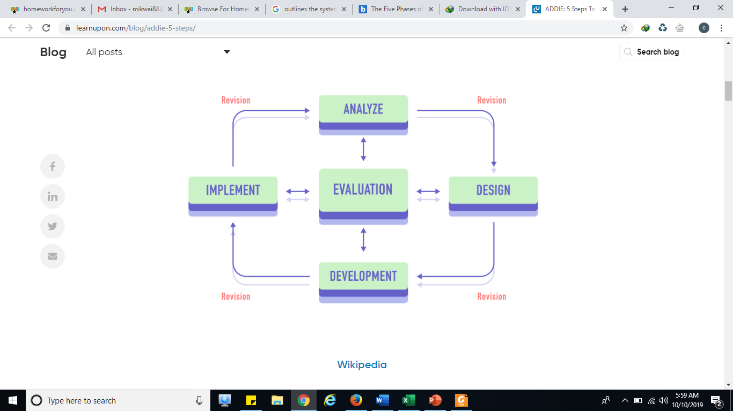
The systems model

Slide 4
Analyze and identify
According to Kraiger, Passmore, and Rebelo, (2015) business organizations have different department performing different roles. Each of the departmental head has a duty and responsibility to determine the training needs for their what they require to be trained on
In most organizations across the globe, analysis which is the initial phase of the training model mode is is done prior to the end of the financial. This is to ensure budget estimates are properly done as it has monetary aspects in the organizations finances.
The employees within the organizations are also called upon to give suggestions based on what attributes they need further training.
At this stage, timelines are identified, trainers analyze all the aspects of an training problem within the organization and start identifying the potential solutions to the problems.
Moreover, training objectives are also created as well as crafting of the training program.

Slide 5
Design
Designing stage entails the mode of delivery, set of teaching plans and assignments intended to test and challenge the employee understanding of the content.
It is at this phase where the learning objectives and outcomes are determined.
Further, the core of the potential training solution is created and explored.
Feedback is received, and initial training solutions begin to take shape.
Some of the types of training solutions, classroom, web-based and blended learning programs are discussed and explored.
the blueprint for your training solution begins to take shape.

Slide 6
Development
At the development phase of the training design model, the training program is crafted as well as written. Training materials are created and produced regardless whether the training is done online or lecture hall based.
The target audience are notified of the training dates, the trainers are trained and all supporting materials are produced.
This is to ensure that there is no confusion at the actual training day.

Slide 7
Implementation
At this stage the training program is delivered to the employees in the implementation phase of the training model.
Classes are taught or taken online. Trainees are accorded opportunity to view the training materials and practice how to use them in their new skills.
The participants are provided with materials and training products and actual training begins.
The trainers are provided with opportunities to test the initial results and provide outcome to the organizations management.
According to Saks, (2015) if the preceding phases are conducted properly, implementation runs smoothly and the training is taken and received as it was intended.

Slide 8
Evaluation
Evaluation is the final stage in the system model of training approach. At this stage, it involves measuring the outcomes of the training program during the implementation stage.
Leaning is measure after the lecture and the results are carefully analyzed.
The entire training program is conducted after all the training is completed. This is to determine whether training was conducted as per the well laid plans.
Further, evaluation, is undertaken to determine whether all the employees attend or interested parties attended the training.
It is also undertaken to determine whether there are any excess which ought to be reduced. The trainers are accorded opportunity to collect feedback from the trainees.

Slide 9
Reasons for Employee Training and Development
Dobmeyer, et al. (2016) organizations in the job market usually undertake trainings to the employees because of the following;
When a performance appraisal indicates performance improvement is needed
To "benchmark" the status of improvement so far in a performance improvement effort
As part of an overall professional development program
As part of succession planning to help an employee be eligible for a planned change in role in the organization
To "pilot", or test, the operation of a new performance management system
To train about a specific topic e.g. communication

Slide 10
Benefits from Employee Training and Development
The supervisors in organizations conduct training to the employees because reasons such as they want to attain;
Increased job satisfaction and morale among employees
Increased employee motivation- staff morale in the work place is drastically improved.
Increased efficiencies in processes, resulting in financial gain
Increased capacity to adopt new technologies and methods

Slide 11
Types of staff training
Onboarding:
This is a process in which new employees are joined in the company. The employee needs to communicate effectively with other colleagues of the organization.
Talent Management:
Finding the right employee for the organization is one of the biggest challenges which most of the companies face.
Performance Management:
Performance management is very necessary for every organization. A little appreciation and gratitude towards the employee will help to boost the morale of the employee.

Slide 12
Training methods to adopt
Some of the training methods that can be adopted include;
On The Job Training
Off-The-Job-Training
Apprenticeship Training
Vestibule Training (Training Centre Training)
Internship Training
Learner Training.

Slide 13
Benefits
Increased innovation in strategies and products
Reduced employee turnover
Enhanced company image, e.g., conducting ethics training (not a good reason for ethics training!)
Risk management, e.g., training about sexual harassment, diversity training

Slide 14
Disadvantages of staff training
Some of the disadvantages of staff training in organizations include;
Waste of time and money- this is because monetary resources are required to for trainers costs, training venues, staff costs such as accommodation, meals among other costs. The staff productive hours are also spend in training rather than work place.
Loss of interest; this may occur when the training hours take long hours. The staff become bored and uninterested in the subject matter. At this point, there is little or no information and data gained at this point as the employees are not listening to the trainers.

Slide 15
Disadvantages
c. Leave for the new job;
Training employees in the organization enable them become updated with the latest knowledge and skills. They are well prepared as well as ready to move to new organizations where there are better offers and salary.
d. Control of training;
In circumstances where training is outsourced, the trainers are not able to determine how skilled and talented the employee is unlike their supervisors who interact with them on daily basis. Therefore, the employers have a duty to think what the employee is thinking about to ensure that they acquire the best from the training. Further, the employee may pick some bad habits and end up with quality less training hence spoiling the complete. Therefore, it is necessary for the trainers to have good control over training.

Slide 16
References
Kraiger, K., Passmore, J., & Rebelo, N. (2015). The psychology of training, development, and performance improvement. The Wiley Blackwell handbook of the psychology of training, development, and performance improvement, 1-9.
Dobmeyer, A. C., Hunter, C. L., Corso, M. L., Nielsen, M. K., Corso, K. A., Polizzi, N. C., & Earles, J. E. (2016). Primary care behavioral health provider training: Systematic development and implementation in a large medical system. Journal of clinical psychology in medical settings, 23(3), 207-224.
Saks, A. (2015). Managing Performance Through Training & Development, (Canadian ed.). Nelson Education.

Slide 17
Thank you

